Slide 1



LONG AN UNIVERSITY OF ECONOMICS AND INDUSTRY REGULAR TRAINING CENTRE
ENGLISH TEACHING METHODOLOGY

Slide 2

Date: 01/10/2023
Name: Vo PhamThanh Luan FINAL EXAM
Class: 22BAV11 Time: 45minutes
Animal journeys
Every year, animals around the world go on long and difficult journeys called migrations.

Slide 3


Animal journeys

Slide 4
Lesson Objective
I can explain how and why animals migrate through the land, sea, and air.
I can predict when an animal will migrate to a new place based on external factors.

Slide 5
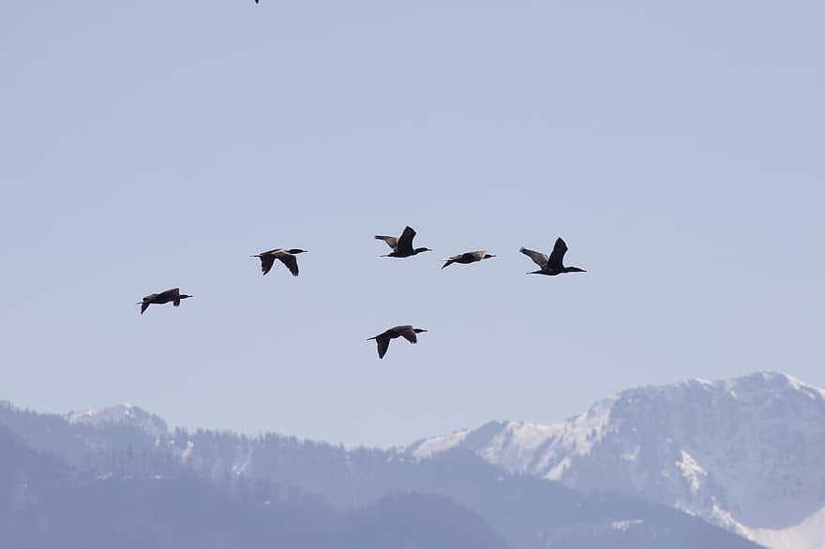
What is migration? Migration is the regular movement of animals from one location to another.
Animal migration is the relatively long-distance movement of individuals, usually on a seasonal basis.
It is found in all major animal
groups.
It can be also defined as :-
A movement leading to the redistribution of individuals within a population.

Slide 6
Prerequisites for migration:
Sustained movement
Physical endurance
Mechanisms for storing energy
Designated food sources on the migration route
Migration ensures animals will have adequate food supplies & will be able to reproduce.

Slide 7
The study of periodic phenomena (such as migration) in animals in relation to changes ,climatic and other ecological factors are called phenology

Slide 8





Evolutionary model of migration (baker 1978)
Animal tend to assess the utility of their present habitat (h1)
relative to that of another potential habitat (h2).
They migrate only when the utility of h1 drops below that of h2 multiplied by a migration factor (m)
(ie., h1 is less than that of h2m)
migration
Individual
migration
Species
migration
accidential
Non-accidential
Non-calculated
calculated
dispersal
exploratory
removal
periodic
seasonal

Slide 9
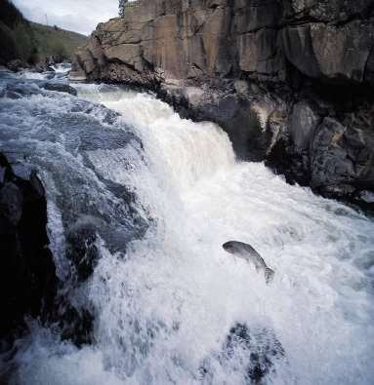
Types of Migration
Migration may occur:
As a round trip
As a return migration
Corresponds with the seasons
Some require a lifetime to complete:
Ex: Pacific salmon
Born in freshwater streams Travel to the ocean
Return to the stream where they were born
Spawn and then die

Slide 10
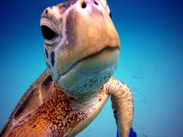
Knowing When to Migrate
How do animals know when it is time to migrate?
Internal signals
Hormones trigger an
overwhelming urge to…
eat, mate & reproduce
External signals (clues)
Temperature change
Daylight hours
Scarce food supply

Slide 11


New word
spring | /ˈspɹɪŋ/, /spɝˈɪŋ/ | the season of the year between winter and summer, lasting from March to June north of the equator, and from September to December south of the equator, when the weather becomes warmer, leaves and plants start to grow again and flowers appear:
journey | /ˈdʒɜː.ni/ | an act of travelling from one place to another, especially when they are far apar
animal | /ˈæn.ɪ.məl/ | something that lives and moves but is not a human, bird, fish, or insect
Antelopes | /ˈæntɪləʊp/ | an African or Asian animal, like a deer, that runs very fast. There are many types of antelope
Frog | (n):/frɒɡ/ | a small animal with smooth skin, that lives both on land and in water (= is an amphibian). Frogs have very long back legs for jumping, and no tail

Slide 12
Word | Pronunciation
tree frog | /ˈtriː frɒɡ/
journey | /ˈdʒɜːrni/
shorter | /ˈʃɔːrtər/
easier | /ˈiːziər/
spring | /sprɪŋ/
climb | /klaɪm/
metre | /ˈmiːtər/
lay | /leɪ/
egg | /eɡ/
water | /ˈwɔːtər/
difficult | /ˈdɪfɪkəlt/

Slide 13
Migration Destinations
How do animals know where to go?
Specialized abilities to navigate
External forces
Ex.: wind & water currents
Landmarks:
Ex.: coastlines, mountain ranges, river
valleys & distinctive odors
Sun:
Track the passage of days and months
Track their position in relationship to the sun

Slide 14
Internal Clues
Are sensitive to a mineral known as
magnetite
Found in many animals, including humans
Allows animals to use the earth’s magnetic field as a guide.
Ex.: Gray whales
Large amount of magnetite in their retinas
Helps them navigate their 10,000 mile journey

Slide 15
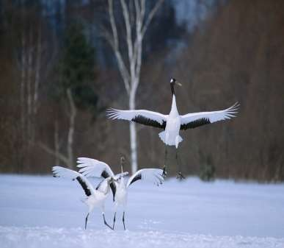
Migration Behaviors
Most animals must learn their migratory routes.
Older members of the group teach the younger animals:
The route traveled
Valuable strategies and/or behaviors
Humans teach younger
animals, too.
Animals who are not taught these behaviors will not likely survive.

Slide 16
Shortage of food supply on the breeding ground
Environmental factors
Internal factors
Photoperiodism
Fat deposition

Slide 17
Pattern of migration?
3 types
Diurnal and tidal movements
Seasonal movements between habitats
long distance migration
1.DIURNAL AND TIDAL MOVEMENTS
Many species move from one habitat to another and back again repeatedly during their life
time scale involved may be hours ,days, month or years
Eg : crabs on shoreline (tidal movement)
Diurnal migration involve moving between to
habitats,each of which can supply limited resources
Eg : planktonic algae both in sea and fresh water lakes move depth @ night but move to surface during day.

Slide 18
2.SEASONAL MOVEMENT BETWEEN HABITAT
Seasonal movement between habitat
The path of environment in which the resources are available change with seasons and population move one patch to another
eg : altitudinal migration of mule deer and american elk (move to high mountain during summer &down to valleys in winter)

Slide 19
3.LONG DISTANCE MIGRATION
Travells long distance
Eg: terrestrial bird in northern hemisphere move north in the spring when the food supplies will become abundant during summer period
Move to south savannahs in the autumn when food become abundant only after the rainy season
so long distant migration seems to involve transit between area that have supply of abudant food but only for a limited period
Eg: swallows

Slide 20
Which animals migrate?
birds
fishes
mammals
reptiles
amhibians
invertebrates

Slide 21

It is the seasonal movement from one habitat to another and back again ,to get the advantages of favorable conditions
Traditional, hereditary ( instinctive), regular occurrence at definite intervals every year
Usually , birds migrate from northern hemisphere in spring to breed and return to southern hemisphere in autumn to pass the winter

Slide 22
Over 5 billion land birds of 187 species migrate between Europe and Asia to Africa
Over 5 billion land birds of over 200 species migrate between North America and the New World tropics
75% of 650 bird species that nest in N. America migrate

Slide 23




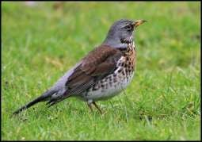
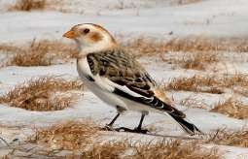
Migrating bird is called migrant
1.Winter visitors ( N S)
Include those species move from their breeding ground to spent their winter in a suitable place ,food is also plenty
Field fare, snow bunting, red wing
grey lag goose, pintail, common teal, gadwal, european starling are the winters visitors (migrants) visiting keoladeo national park,bharatpur
Field fare
Snow bunting

Slide 24

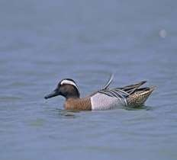
2. Summer visitors(S N)
Spring onwards ,south start getting hot
the birds of south leave it in spring for nort to spend the summer ,breed & return to sout in autumn ,
eg: swifts swallows,nightingales,cuckoo
3.Transient visitors or passage migrants
These are summer and winter visitors whil migrating from south to north and vice versa
Stop at some places for the sake of rest only
Eg: gargany teals migrate from mangolia o siberia to bharatpur to go south india which is their actual breeding ground,while returning thet again stop over @ bharat pur
h
h
swift
e
r
Gargany teals

Slide 25

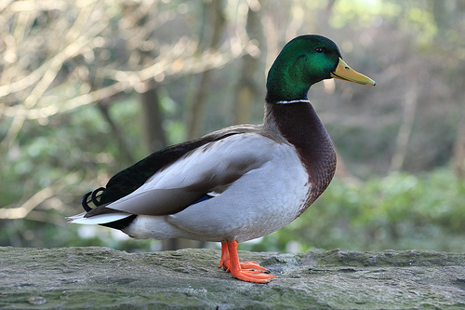
4.Permanent resident
these birds found in a particular area through out the year and do not migratefrom one place to another
Eg: cotton teal, spotbill duck, whistling teal, barheaded goose, mallard,comb duck
these birds are permanent residents of keoladeo national park ,bhartpur

Slide 26
Word | Pronunciation
antelope | /ˈæntɪləʊp/
Central Asia | /ˈsɛntrəl eɪʒə/
spring | /sprɪŋ/
walk | /wɔːk/
higher places | /ˈhaɪər pleɪsɪz/
food | /fuːd/
male | /meɪl/
female | /ˈfiːmeɪl/
calf | /kæf/
dangerous | /ˈdeɪnʒərəs/
journey | /ˈdʒɜːrni/

Slide 27





1.Daily migration
Many birds make daily movements from their nest in response to environmental forces such as light,darkness temperature,humidity etc.
Daily migration from their resting site to feeding area.
Eg: crows , sparrows, starling
2.Local migration
Local migration occurs because of heavy rain, flood,excessive cold &hot
Return to that area when crisis is over
Flowering of certain plants and ripening of fruits also cause local migration

Slide 28
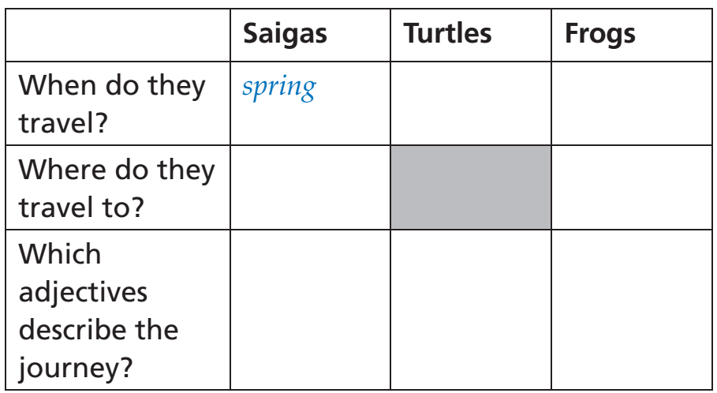
Lesson Objective

Slide 29


Slide 30
Question: What kind of animal is in the image?
Answer: Saiga antelope
Question: Where do saiga antelopes live?
Answer: Central Asia
Question: Why do saiga antelopes walk to higher places in the spring?
Answer: To find food
Question: How far can a male saiga antelope walk in a day?
Answer: 35 kilometers
Question: Is it faster for a male or female saiga antelope to walk?
Answer: A male saiga antelope is faster than a female
Question: Why is the journey more dangerous for a female saiga antelope?
Answer: Because she has her calf in the spring

Slide 31
1. Saiga antelopes live in ________.
a) Africa
b) Central Asia
c) South America
2. In which season do Saiga antelopes walk to higher places for food?
a) Summer
b) Spring
c) Winter
3. A male saiga can walk ________ kilometers a day.
a) 10
b) 20
c) 35
4. Is the male saiga faster than the female saiga?
a) Yes
b) No
c) It depends on the season
5. Why is the journey more dangerous for a female saiga in the spring?
a) Because she doesn't like the spring weather
b) Because she has her calf in the spring
c) Because there is less food available in the spring
6. What is the main reason Saiga antelopes make this journey?
a) To find a mate
b) To escape from predators
c) To find food
7. Saiga antelopes are known for their long ________ during the spring.
a) hibernation
b) migration
c) sleep
8. Which continent is Central Asia located on?
a) Europe
b) Asia
c) Africa
Answers: 1.b) Central Asia 2.b) Spring 3.c) 35 4.a) Yes 5.b) Because she has her calf in the spring 6.c) To find food 7.b) migration 8.b) Asia

Slide 32
Question: What kind of animal is in the image?
Answer: Tree frog
Question: What is the tree frog doing in the image?
Answer: Laying its eggs in water
Question: Why do tree frogs have to climb down trees to lay their eggs in water?
Answer: Because tree frogs are amphibians, which means they need to live in both water and on land. Their eggs need to be laid in water in order to hatch.
Question: How far does the tree frog have to climb down the tree to lay its eggs?
Answer: 30 meters
Question: Is it easier for a tree frog to climb up the tree or down the tree?
Answer: It is easier for a tree frog to climb up the tree than down the tree. Tree frogs have special adaptations that help them climb, such as sticky toe pads.
Question: Why is the journey to lay eggs so difficult for a tree frog?
Answer: Because tree frogs are small and they have to climb a long distance. Additionally, tree frogs are vulnerable to predators when they are on the ground.

Slide 33
1. Tree frogs have ________ journeys compared to other animals.
a) shorter
b) longer
c) easier
2. In which season do tree frogs make their journey?
a) Summer
b) Autumn
c) Spring
3. During the journey, tree frogs climb ________ meters down a tree.
a) 10
b) 20
c) 30
4. After climbing down the tree, what do tree frogs do?
a) They rest for a while.
b) They lay their eggs in water.
c) They fly to another tree.
5. Where do tree frogs lay their eggs?
a) In the tree branches
b) In the ground
c) In water
6. What do you think makes the journey difficult for tree frogs?
a) Their size
b) The distance they have to climb
c) The weather
7. Tree frogs have to make this journey every ________.
a) year
b) month
c) day
8. This journey is especially challenging for ________ frogs.
a) big
b) small
c) green
Answers: 1.a) shorter 2.c) Spring 3.c) 30 4.b) They lay their eggs in water 5.c) In water 6.a) Their size 7.a) year 8.b) small

Slide 34
Word | Pronunciation
loggerhead turtle | /ˈlɒɡərhed ˈtɜːrtəl/
journey | /ˈdʒɜːrni/
longer | /ˈlɒŋɡər/
sea animal | /ˈsiː ænəməl/
baby | /ˈbeɪbi/
swim | /swɪm/
kilometre | /ˈkɪləmiːtər/
fifteen | /ˈfɪfˌtiːn/
female | /ˈfiːmeɪl/
egg | /eɡ/
beach | /biːtʃ/

Slide 35
Question: What kind of animal is in the image?
Answer: Loggerhead turtle
Question: What is the longest journey that a sea animal can make?
Answer: The loggerhead turtle can make a journey of up to 14,000 kilometers.
Question: Why do loggerhead turtles leave the beach as babies and swim around for 15 years?
Answer: Loggerhead turtles are migratory animals, which means that they travel long distances each year in search of food and breeding grounds.
Question: Where do female loggerhead turtles return to lay their eggs?
Answer: Female loggerhead turtles return to the same beach where they were born to lay their eggs.
Question: Why is it important for loggerhead turtles to return to the same beach to lay their eggs?
Answer: Loggerhead turtles know the beaches where they were born best. These beaches are safe places for them to lay their eggs.

Slide 36
1. Loggerhead turtles have ________ journeys compared to other sea animals.
a) short
b) dangerous
c) longer
2. A loggerhead turtle leaves the beach as a ________.
a) teenager
b) baby
c) adult
3. It swims around ________ kilometers during its journey.
a) 1,000
b) 14,000
c) 5,000
4. How many years later does the female loggerhead turtle return to the same beach?
a) 5 years
b) 10 years
c) 15 years
5. What does the female loggerhead turtle do when she returns to the same beach?
a) Takes a nap
b) Lays eggs
c) Goes for a swim
6. The journey of a loggerhead turtle is a ________ one.
a) very difficult
b) short and easy
c) dangerous
7. Loggerhead turtles are known for their ________ journeys.
a) quick
b) slow
c) long
8. They are also known for their ability to ________ back to the same beach.
a) get lost
b) return
c) stay away
Answers: 1. c) Longer 2. b) baby 3.b) 14,000 4.c) 15 years 5.b) Lays eggs 6.a) very difficult 7.c) long 8.b) return

Slide 37




